Slide 1
430.211 Programming Methodology (프로그래밍 방법론)
Taesup Moon
Department of Electrical and Computer Engineering
Seoul National University

Slide 2
Outline
Chapter 4: Parameters and Overloading
Call-by-value & Call-by-reference
Overloading

Slide 3
Outline
Chapter 4: Parameters and Overloading
Call-by-value & Call-by-reference
Overloading

Slide 4
Ch 4. Parameters and Overloading
Two methods of passing arguments as parameters to a function
Call-by-value
"copy" of value is passed
Call-by-reference
"address of" actual argument is passed

Slide 5
Call-by-Value Parameters
A copy of actual argument is passed
Considered as a "local variable" inside the function
If modified, only the "local copy" is changed
Function has no access to "actual argument” from the caller
This is the default method
Used in all examples so far

Slide 6
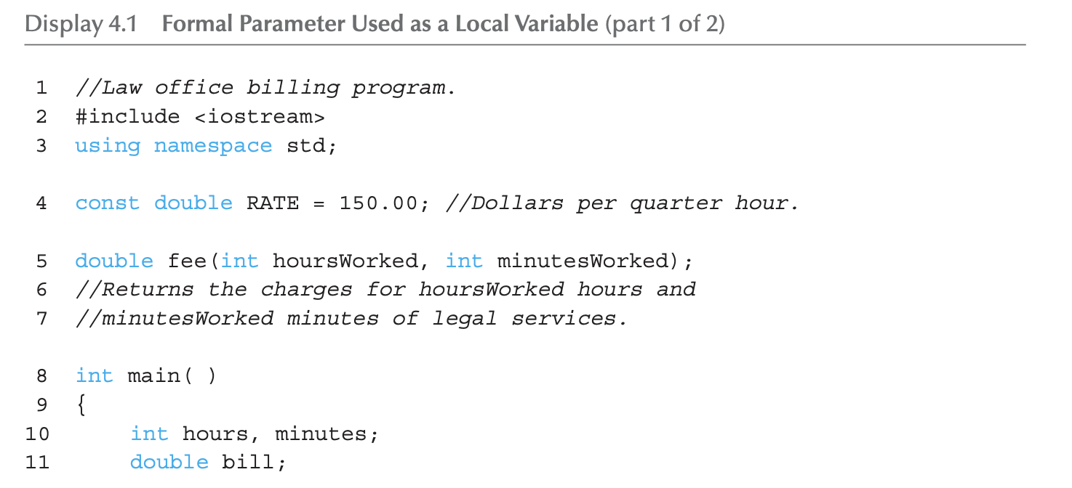
Call-by-Value Example: Display 4.1 Formal Parameter Used as a Local Variable (1 of 3)

Slide 7
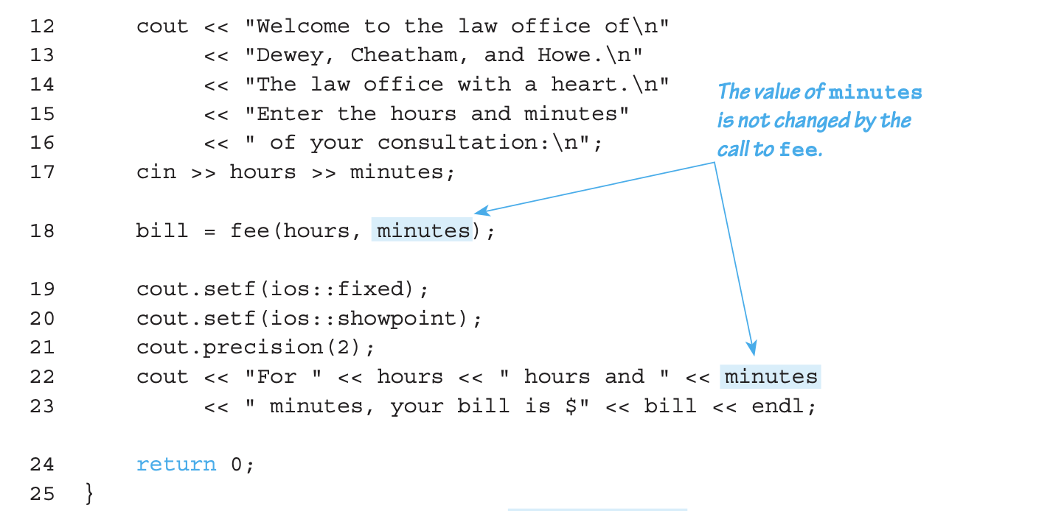
Call-by-Value Example: Display 4.1 Formal Parameter Used as a Local Variable (2 of 3)

Slide 8
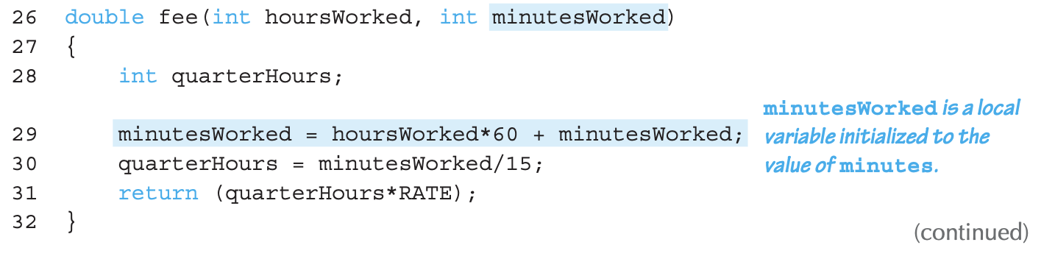
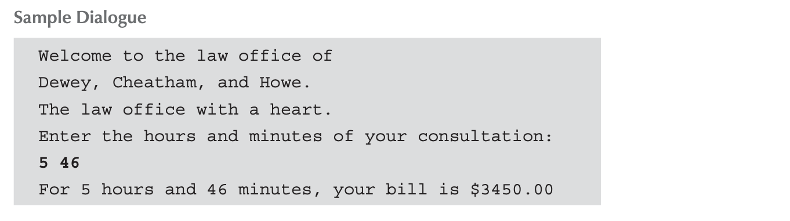
Call-by-Value Example: Display 4.1 Formal Parameter Used as a Local Variable (3 of 3)

Slide 9
Call-by-Value Pitfall
Common Mistake:
Declaring parameter "again" inside function: double fee(int hoursWorked, int minutesWorked) { int quarterHours; // local variable int minutesWorked // NO! }
Compiler error results
"Redefinition error…"
Value arguments are like "local variables"
Function gets them "automatically"

Slide 10
Call-By-Reference Parameters
Used to provide access to caller’s actual argument
Caller’s data can be modified by called function!
Argument MUST be a variable, not a constant
Typically used for input function
To retrieve data for caller
Data is then "given" to caller
Specified by ampersand, &, after type in formal parameter list

Slide 11
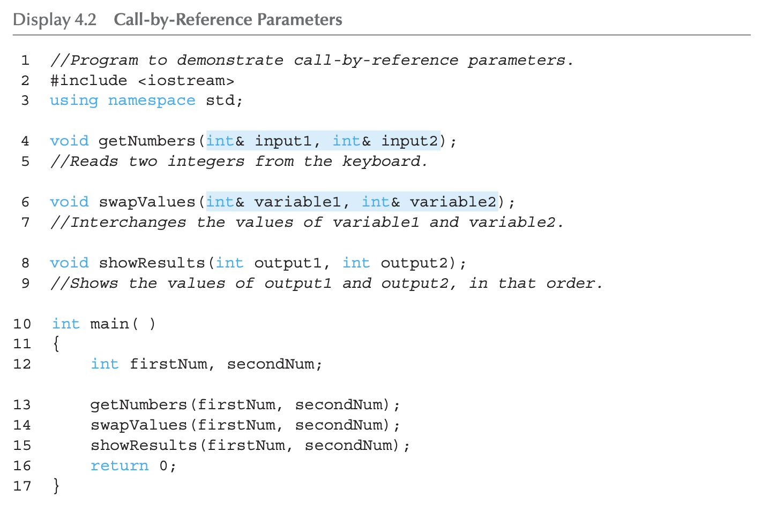
Call-By-Reference Example: Display 4.2 Call-by-Reference Parameters (1 of 3)

Slide 12
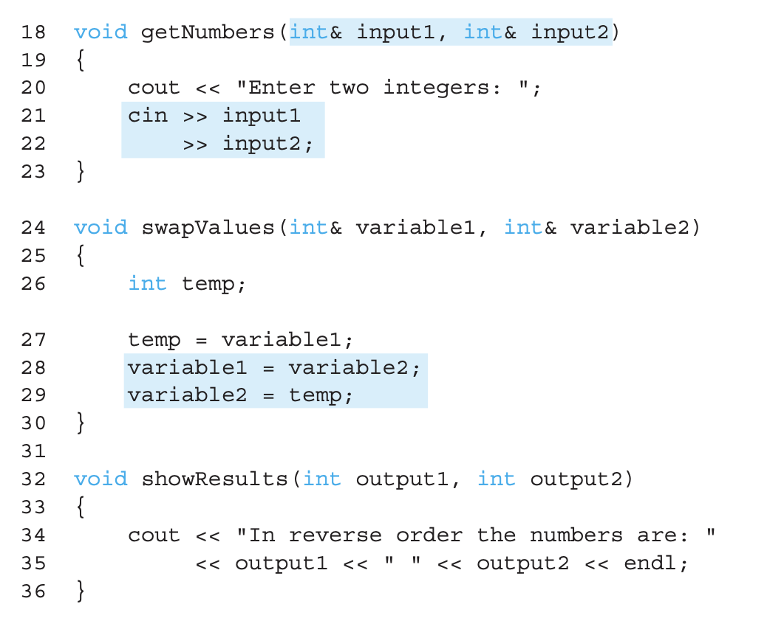
Call-By-Reference Example: Display 4.2 Call-by-Reference Parameters (2 of 3)

Slide 13
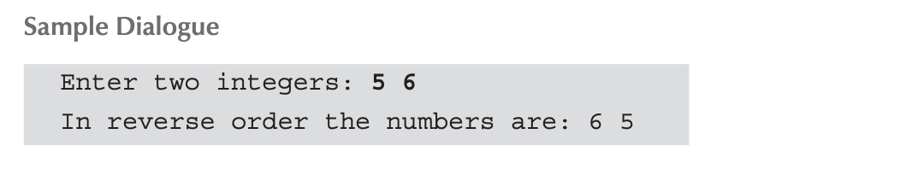
Call-By-Reference Example: Display 4.2 Call-by-Reference Parameters (3 of 3)
Quiz1:
What would be the output if the swapValues is defined with call-by-value parameters? Namely, if we have
void swapValues(int variable1, int variable2)?

Slide 14
Call-By-Reference Example: Display 4.2 Call-by-Reference Parameters (3 of 3)
Quiz2:
What would be the output if the first parameter in swapValues is called-by-value? Namely, if we have
void swapValues(int variable1, int& variable2)?

Slide 15
Call-By-Reference Details
What’s really passed in?
A "reference" to caller’s actual argument!
Refers to memory location of the actual argument
Called "address", which is a unique number referring to distinct place in memory
Pros/Cons of call-by-value in contrast to call-by-reference
Pros: Variables in the calling func are not unexpectedly modified by the called func
Cons: Copying the argument to the parameter takes time

Slide 16
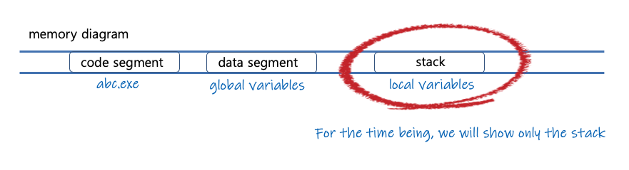
More on Call-by-value /reference : What happens when a function is called?
void swap_using_value(int a, int b) { int tmp = a; a = b; b = tmp; }
void swap_using_ref(int& a, int& b) { int tmp = a; a = b; b = tmp; }
void f_with_const_ref(const int& a) { /* computation using a...*/ }
void main() {
int u,v;
u = 1, v = 2; swap_using_value(u,v);
u = 1, v = 2; swap_using_ref(u,v);
u = 1, v = 2; f_with_const_ref(u); std::cout << u << "\n”;
}

Slide 17
More on Call-by-value /reference : What happens when a function is called?
void swap_using_value(int a, int b) { int tmp = a; a = b; b = tmp; }
void swap_using_ref(int& a, int& b) { int tmp = a; a = b; b = tmp; }
void f_with_const_ref(const int& a) { /* computation using a...*/ }
void main() {
int u,v;
u = 1, v = 2; swap_using_value(u,v);
u = 1, v = 2; swap_using_ref(u,v);
u = 1, v = 2; f_with_const_ref(u); std::cout << u << "\n”;
}
stack
u
v
a
b
tmp
1
2
abc.exe중 돌아갈 주소
함수값을 여기에
1
2
≡ a
≡ b
u
v
tmp
1
2
abc.exe중 돌아갈 주소
함수값을 여기에

Slide 18
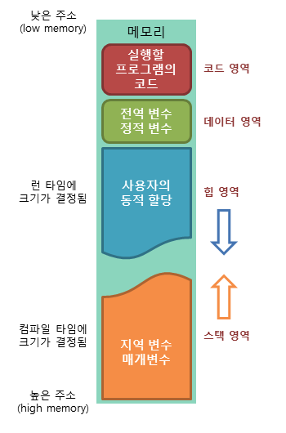
Memory Structure
Stack
Local variable, array, etc.
No explicit memory managements
Variables stored sequentially
Heap (later)
Dynamic memory allocation (pointer)
Explicit memory managements
Variables stored in different locations

Slide 19
Constant Reference Parameters
Reference arguments are inherently "dangerous"
Caller’s data can be changed
Often this is desired, sometimes not
To "protect" data and still pass by reference:
Use const keyword
void sendConstRef( const int &par1, const int &par2);
Makes arguments "read-only" by function
No changes allowed inside function body

Slide 20
Mixed Parameter Lists
Can combine passing mechanisms
Parameter lists can include call-by-value and call-by-reference parameters
Order of arguments in list is critical: void mixedCall(int & par1, int par2, double & par3);
Function call: mixedCall(arg1, arg2, arg3);
arg1 must be integer type, is passed by reference
arg2 must be integer type, is passed by value
arg3 must be double type, is passed by reference

Slide 21
Outline
Chapter 4: Parameters and Overloading
Call-by-value & Call-by-reference
Overloading

Slide 22
Function Overloading
Same function name, but different parameter lists
Two separate function definitions
Function "signature”
Function name & parameter list (excluding & and const)
Must be "unique" for each function definition
Function overloading allows same task performed on different data

Slide 23
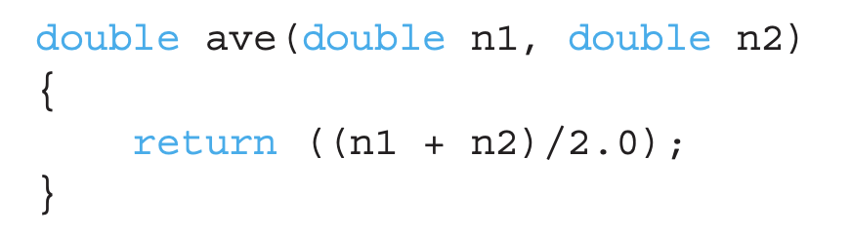
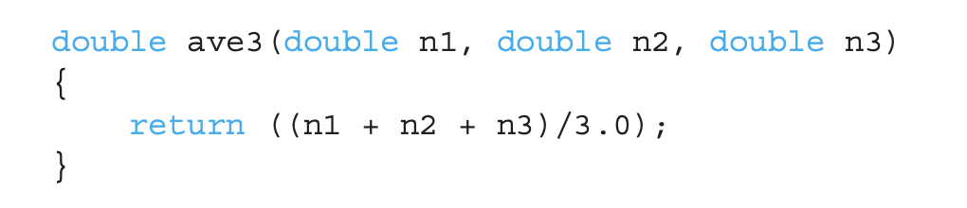
Overloading Example: Average
A function that computes average of 2 numbers:
What if we want to compute average of 3 numbers?
Does not look so elegant

Slide 24
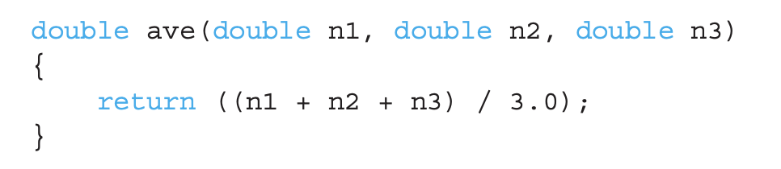
Overloading Example: Average
A more elegant solution
Only differs in the parameter list
But, there is no ambiguity → a compiler can check the number of arguments when the functions are called (different prototype!)
mean = ave(5.2, 6.7) → calls 2-parameter version ave
mean = ave(6.5,8.5,4.2) → calls 3-parameter version ave
Same name!

Slide 25
Overloading
How much can we overload?
Different number of formal parameters
One or more parameters with different types
Different return type with the same formal parameters
Difference in const or call-by-value/reference
Operator overloading
Ex) 13/2 vs. 13/2.0 → depending on the operand, the operator behaves differently
Function overloading is user-defined overloading!
Operator overloading will be covered in Ch.8!
Yes!
Yes!
No!
No!

Slide 26
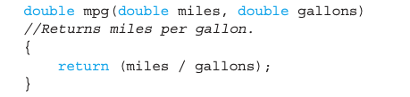
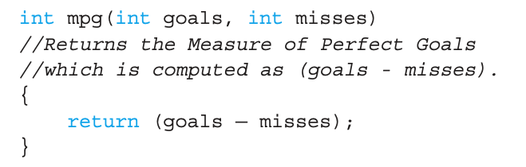
Overloading pitfalls
Automatic type conversion + overloading can cause some confusion
int variable will be converted to double → 22.5 miles/gallon
Automatic conversion is helpful
Suppose we have another overloaded function
Legitimate overloading because it has different parameter types! But…
will print 43, which is not an intended answer.
→ DO NOT overload for two unrelated functions!

Slide 27
Overloading Resolution
1st: Exact Match
Looks for exact signature
Where no argument conversion required
2nd: Compatible Match
Looks for "compatible" signature where automatic type conversion is possible:
1st with promotion (e.g., int→double)
No loss of data
2nd with demotion (e.g., double→int)
Possible loss of data

Slide 28
Automatic Type Conversion and Overloading Example
double kpl(double kms, double liters) {return (kms/ liters);}
Example function calls:
kplComputed = kpl(5, 20);
Converts 5 & 20 to doubles, then passes
kplComputed = kpl(5.8, 20.2);
No conversion necessary
kplComputed = kpl(5, 2.4);
Converts 5 to 5.0, then passes values to function

Slide 29
Automatic Type Conversion and Overloading Example
double kpl(int kms, int liters) {return (kms/ liters);}
Example function calls:
kplComputed = kpl(5, 20);
No conversion necessary
kplComputed = kpl(5.8, 20.2);
Converts 5.8 & 20.2 to ints, then passes
kplComputed = kpl(5, 2.4);
Converts 2.4 to 2, then passes values to function

Slide 30



Overloading Resolution Confusing Example
Given following functions:
What happens if we call ? Not clear which one to call
Now suppose we have
f(98, 99); → Calls (3) f(5.3, 4); → Calls (2) f(4.3, 5.2); → Calls ???
Try to avoid such confusing overloading
(1)
(2)
(3)

Slide 31
Default Arguments
Allows omitting some arguments
Specified in function declaration/prototype
void showVolume( int length, int width=1,int height=1);
Last 2 arguments are defaulted
Possible calls:
showVolume(2,4,6); //All arguments supplied
showVolume(3,5); //height defaulted to 1
showVolume(7); //width & height defaulted to 1

Slide 32
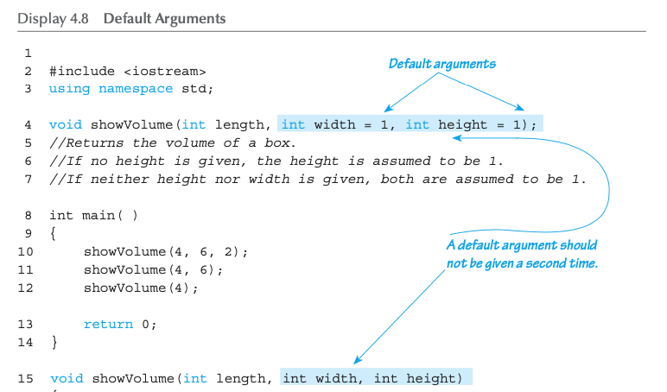
Default Arguments Example: Display 4.8 Default Arguments (1 of 2)

Slide 33
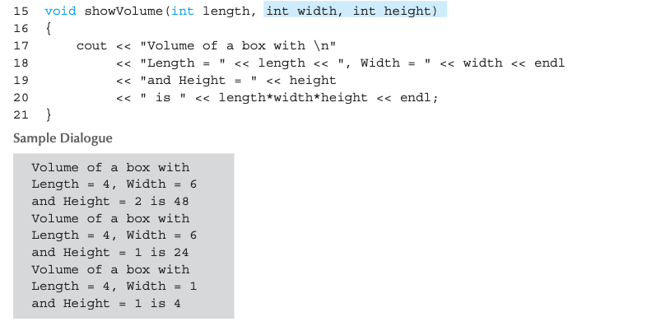
Default Arguments Example: Display 4.8 Default Arguments (2 of 2)

Slide 34
Summary 1
Formal parameter is placeholder, filled in with actual argument in function call
Call-by-value parameters are "local copies" in receiving function body
Actual argument cannot be modified
Call-by-reference passes memory address of actual argument
Actual argument can be modified
Argument MUST be a variable, not a constant

Slide 35
Summary 2
Multiple definitions of same function name possible → called overloading
Default arguments allow function call to "omit" some or all arguments in list
If not provided → default values assigned

Slide 36
Thank you!
Web: http://mindlab-snu.github.io
E-mail: tsmoon@snu.ac.kr

